Slide 1
Digital logic circuits

Slide 2
Topics in this chapter
1. Digital Computers
2. Logic Gates
3. Boolean Algebra
4. Map Simplification
5. Combinational Circuits
6. Flip-Flops
7. Sequential Circuits

Slide 3
1. Digital Computers
Digital- The word digital implies that the information in the computer is represented by variables that take a limited number of discrete values.
Bit- Digital computer use the binary number system having two digits: 0 and 1, this binary digit is called a bit.
Program- A sequence of instruction for the computer.

Slide 4
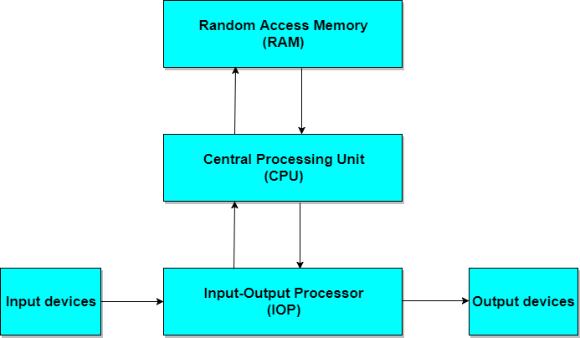
Block diagram of a digital computer

Slide 5
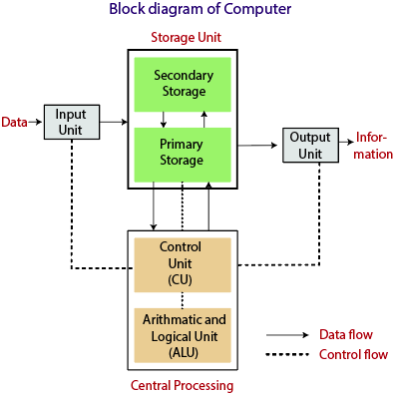
Block diagram of a digital Computer

Slide 6
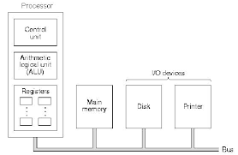

Slide 7
Registers
Register is a very fast computer memory, used to store data/instruction in-execution.
A Register is a group of flip-flops with each flip-flop capable of storing one bit of information.
An n-bit register has a group of n flip-flops and is capable of storing binary information of n-bits.
A register consists of a group of flip-flops and gates. The flip-flops hold the binary information and gates control when and how new information is transferred into a register.
Various types of registers are available commercially. The simplest register is one that consists of only flip-flops with no external gates.

Slide 8
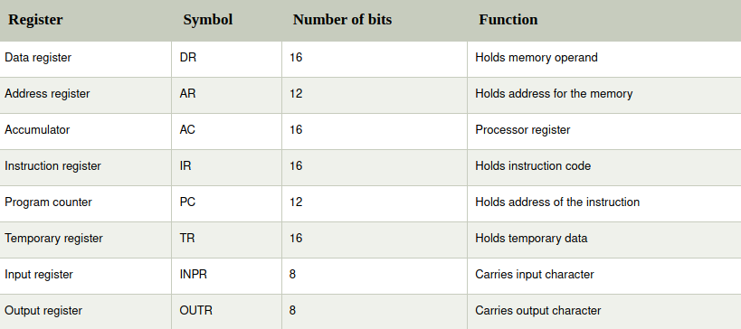

Slide 9
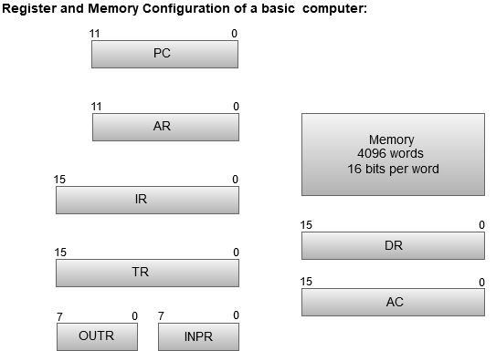

Slide 10
The Memory unit has a capacity of 4096 words, and each word contains 16 bits.
The Data Register (DR) contains 16 bits which hold the operand read from the memory location.
The Memory Address Register (MAR) contains 12 bits which hold the address for the memory location.
The Program Counter (PC) also contains 12 bits which hold the address of the next instruction to be read from memory after the current instruction is executed.
The Accumulator (AC) register is a general purpose processing register.
The instruction read from memory is placed in the Instruction register (IR).
The Temporary Register (TR) is used for holding the temporary data during the processing.
The Input Registers (IR) holds the input characters given by the user.
The Output Registers (OR) holds the output after processing the input data.

Slide 11
Computer Organization- It is concerned with the way the hardware components operate and the way they are connected together to form the computer system.
Computer Design- It is concerned with the determination of what hardware should be used and how the parts should be connected.
Computer Architecture- It is concerned with the structure and behaviour of the computer as seen by the user.

Slide 12
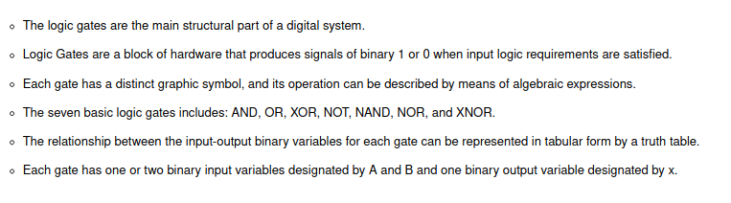
2. Logic gates

Slide 13
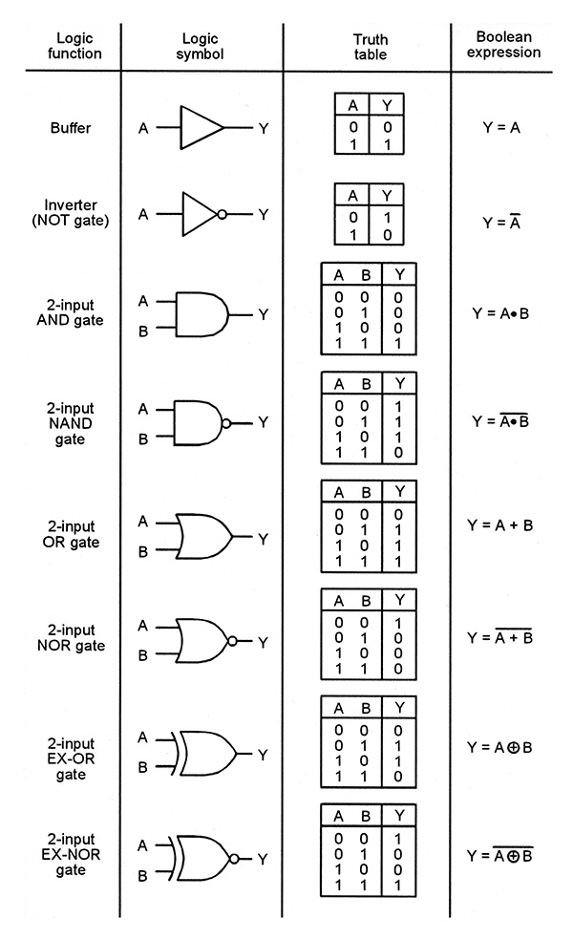
Buffer gate:-
Algebraic Expression:
Y=A
Graphic Symbol:
Truth Table:

Slide 14
Inverter (not) gate:-
Algebraic Expression:
Y=A’
Graphic Symbol:
Truth Table:

Slide 15
AND Gate:-
Algebraic Expression:
Y=A*B or Y=A.B or Y=AB
Graphic Symbol:
Truth Table:

Slide 16
Nand gate:-
Algebraic Expression:
Y=(A*B)’ or Y=(A.B)’ or Y=(AB)’
Graphic Expression:
Truth Table:

Slide 17
Or gate:-
Algebraic Expression:
Y=A+B
Graphic Symbol:
Truth Table:

Slide 18
Nor gate:-
Algebraic Expression:
Y=(A+B)’
Graphic Symbol:
Truth Table:

Slide 19
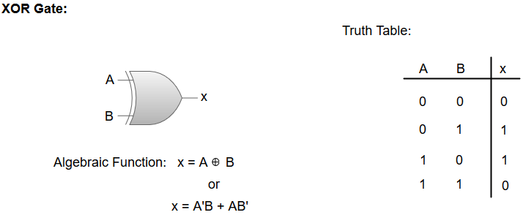
Exclusive or (Xor):-

Slide 20
3. boolean algebra
It is an algebra that deals with binary variable and logic operations.
Boolean Function:
It can be expressed algebraically with binary variables,logic operation symbols, parentheses, and equal sign.
Truth Table:
It is the representation of a function in a list of 2^{n} combinations of the n binary variables.

Slide 21
Identities of boolean algebra..
x+0=x
x+1=1
x+x=x
x+x’=1
x+y=y+x
x+(y+z)=(x+y)+z
x(y+z)=xy+xz
(x+y)’=x’y’
(x’)’=x
x.0=0
x.1=x
x.x=x
x.x’=0
x.y=y.x
x(y.z)=(x.y)z
x+yz=(x+y)(x+z)
(xy)’=x’+y’

Slide 22
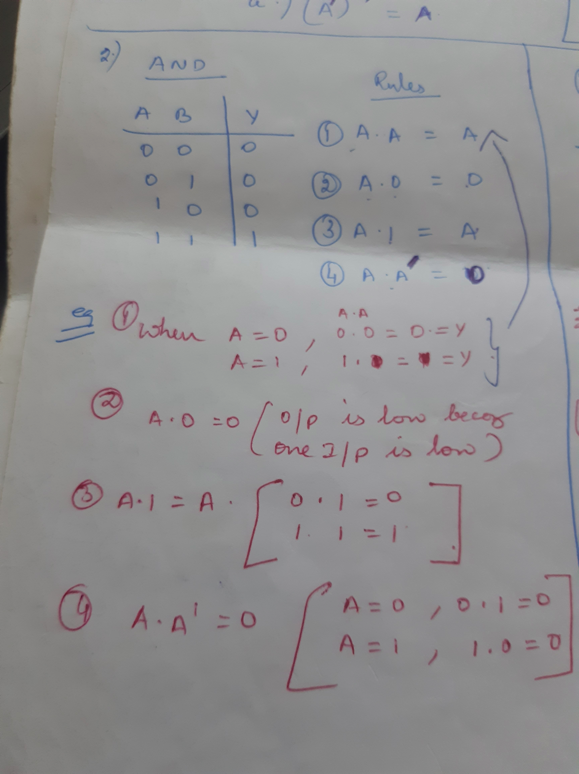

Slide 23
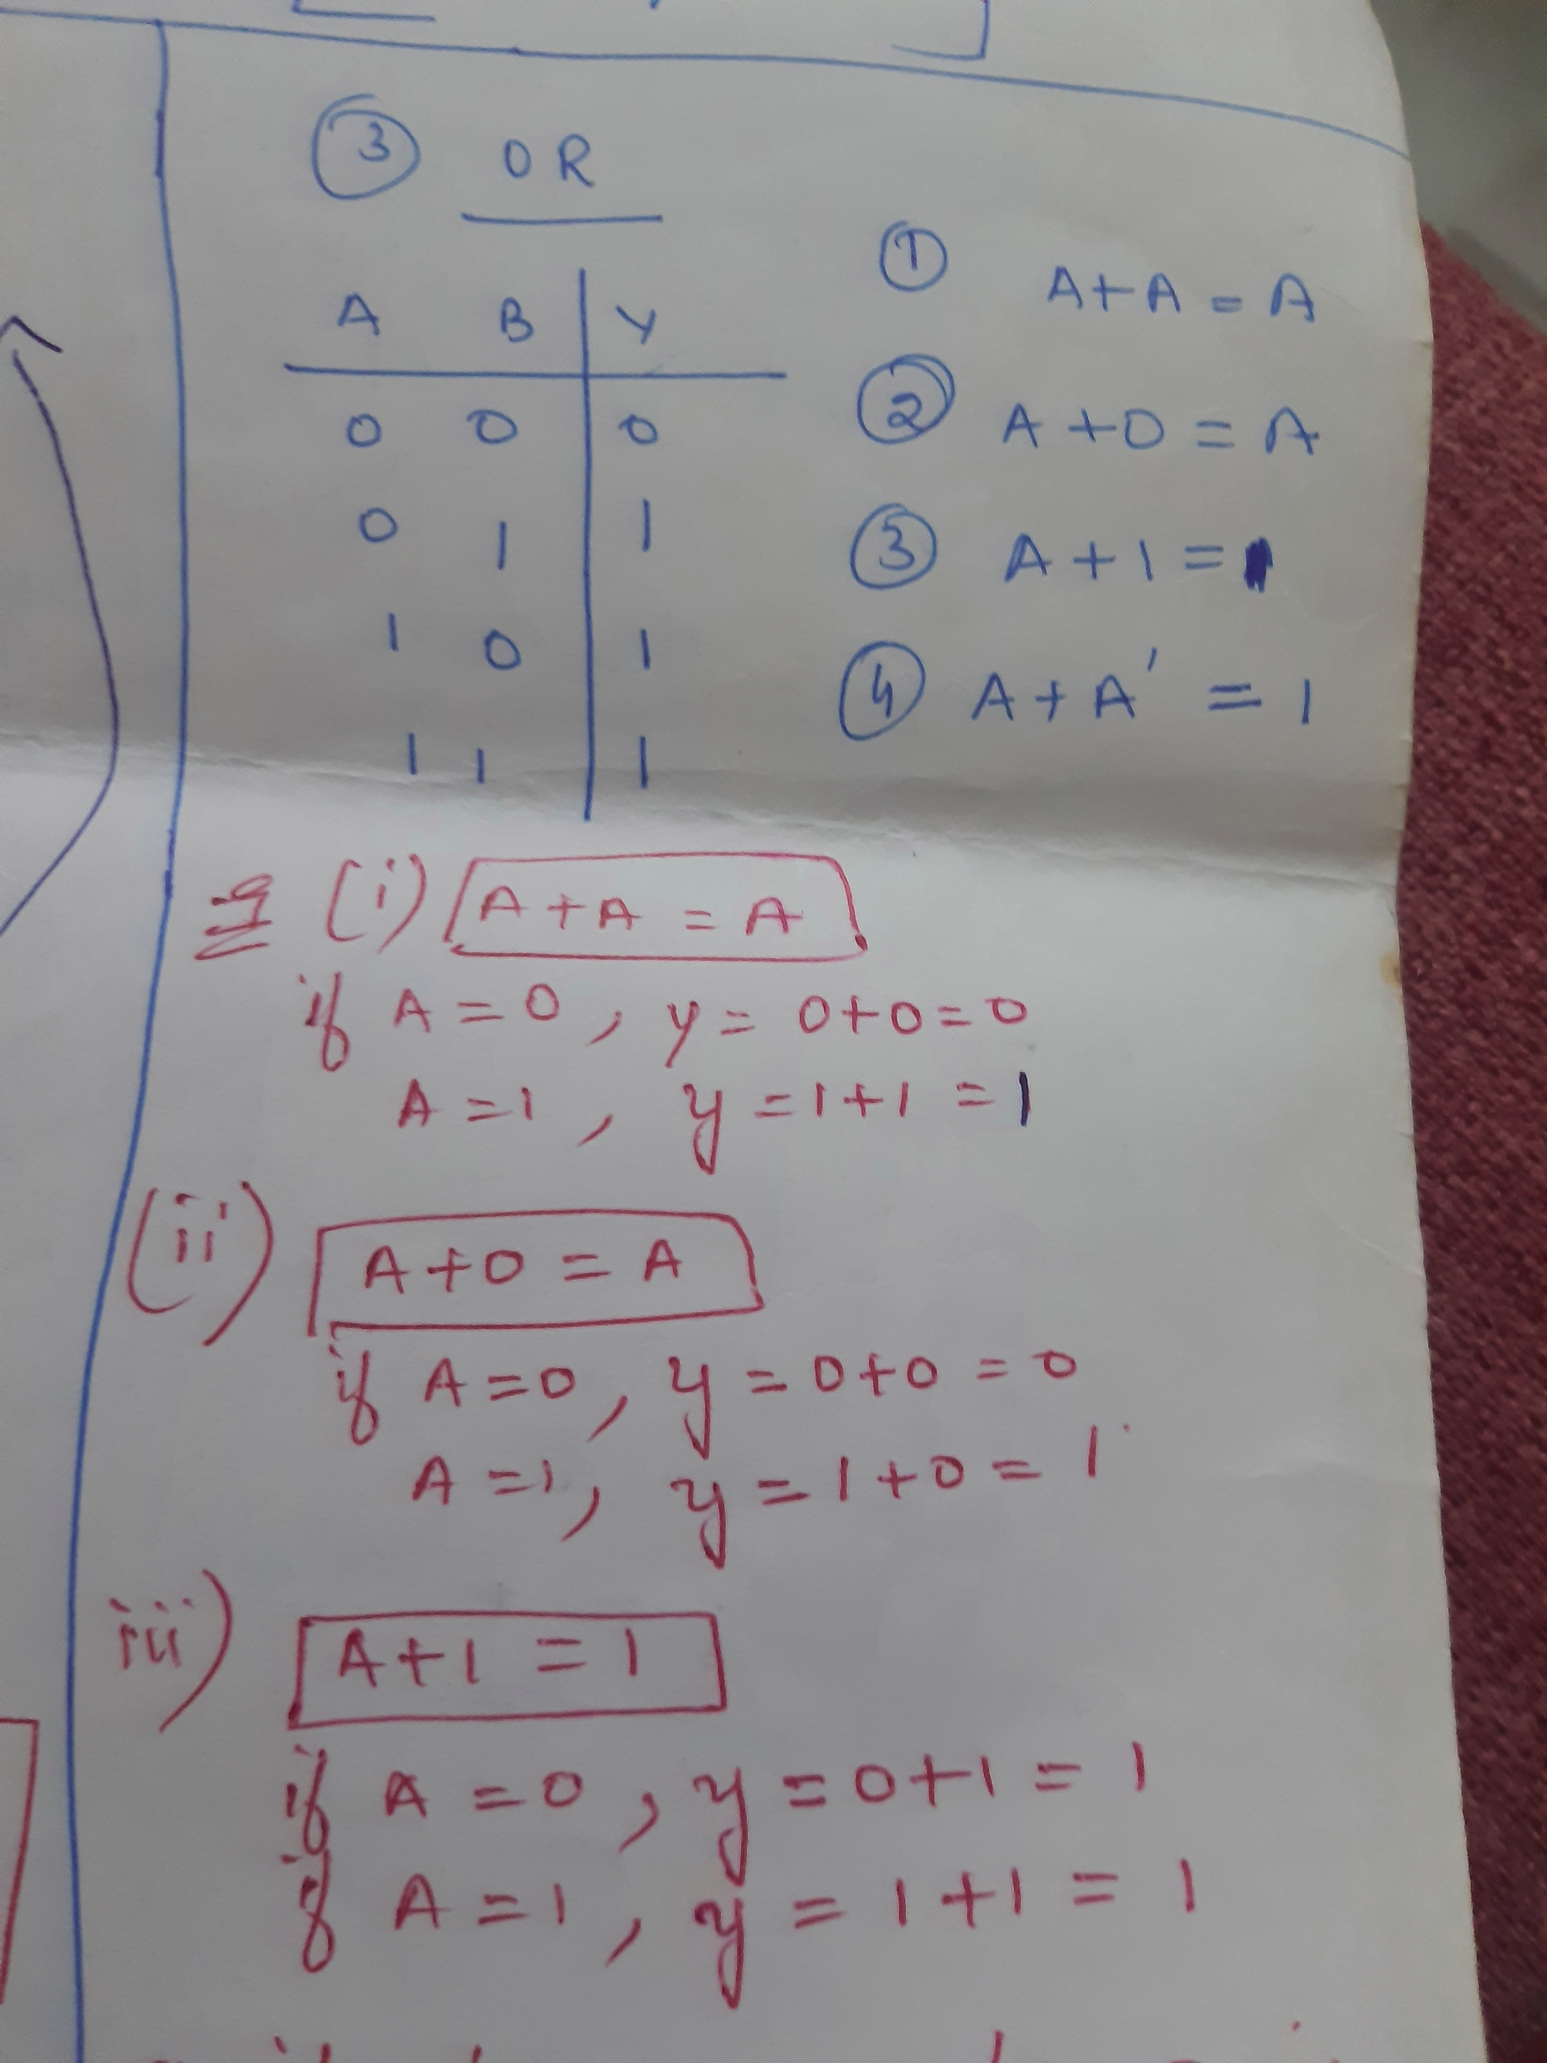

Slide 24
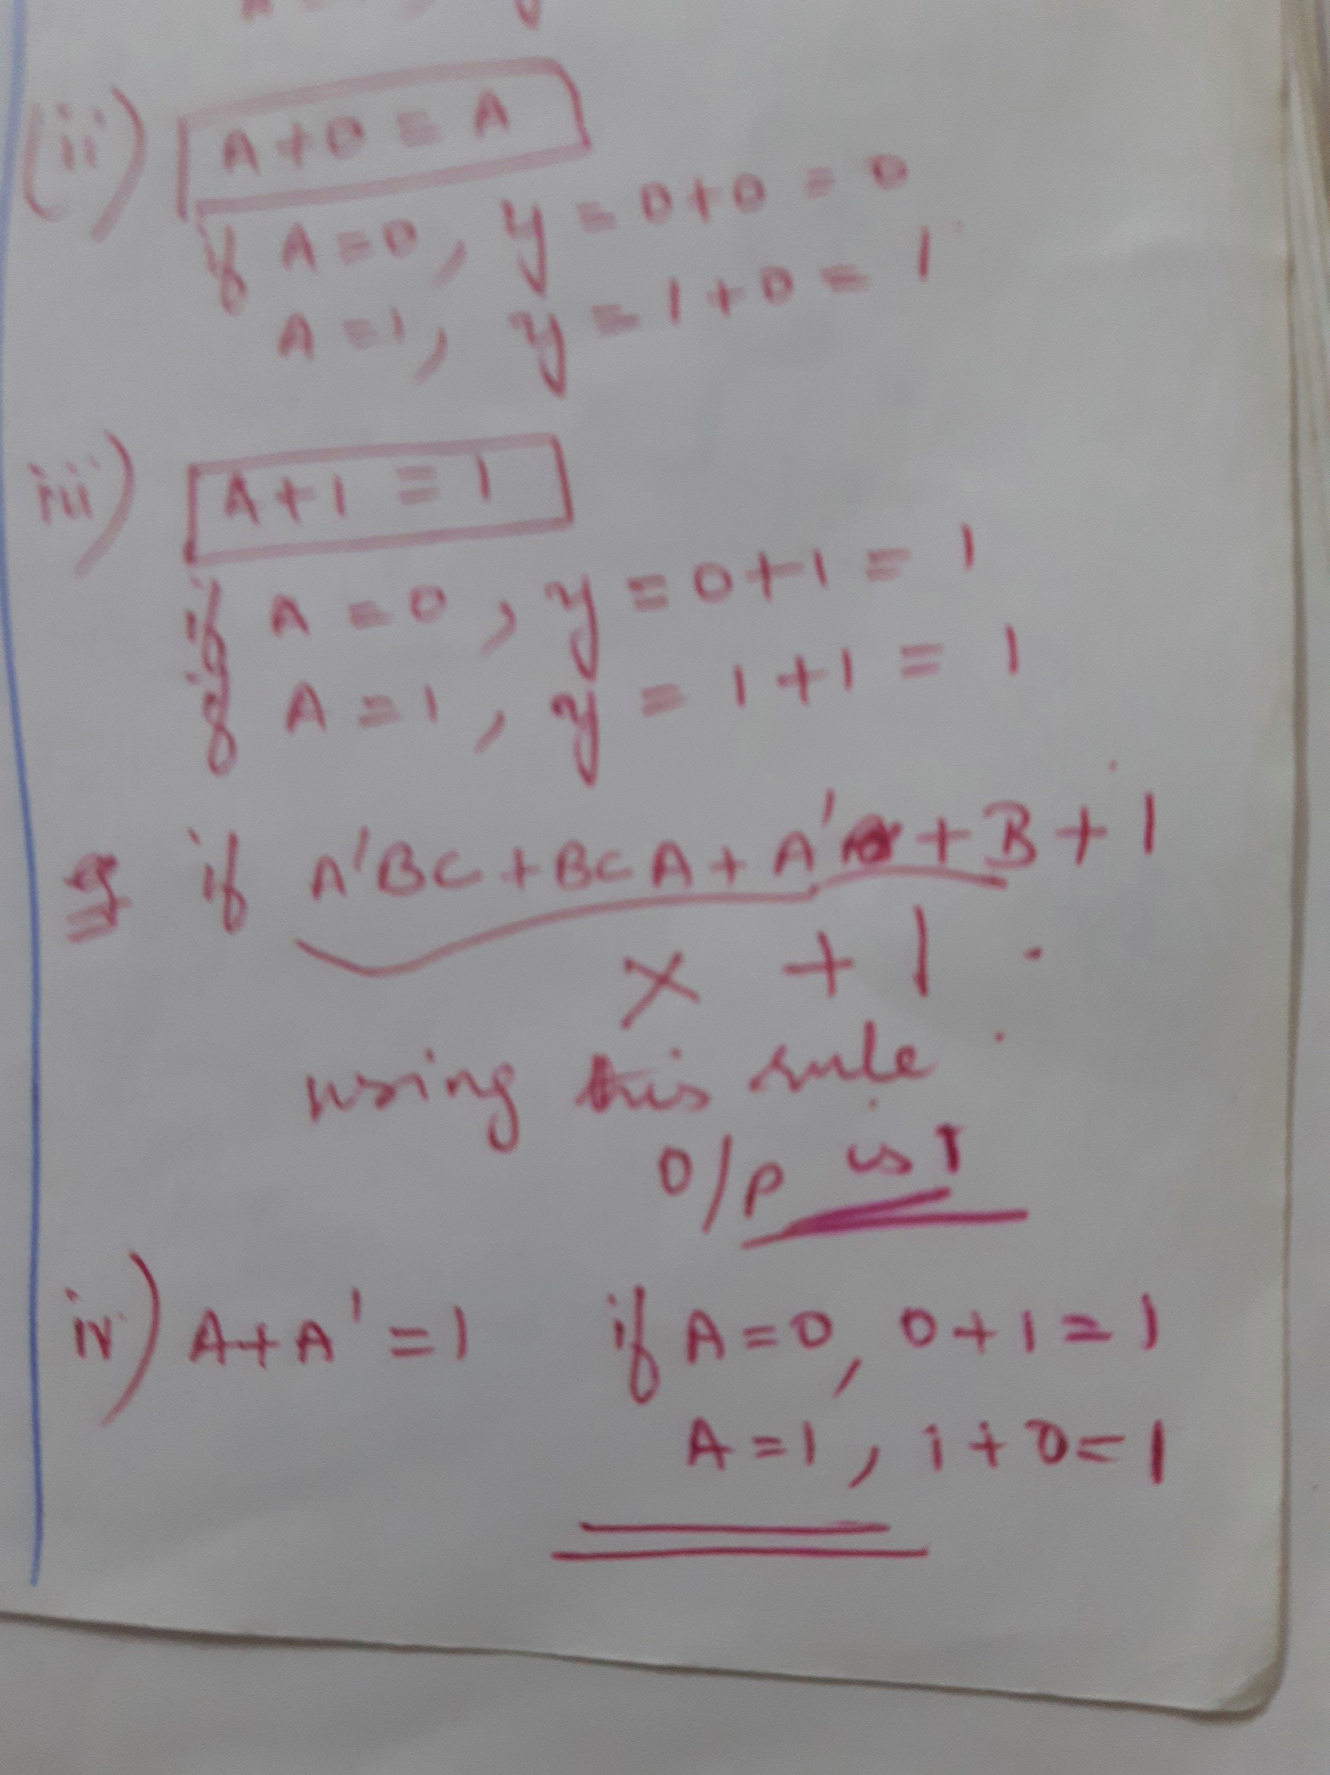

Slide 25
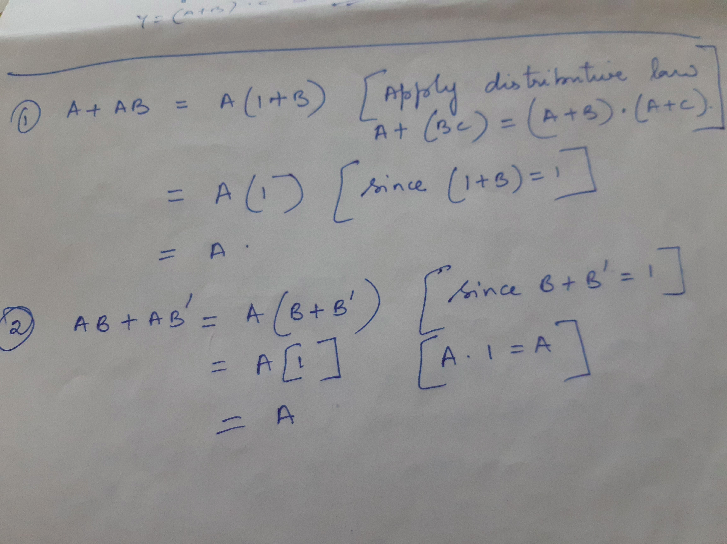

Slide 26
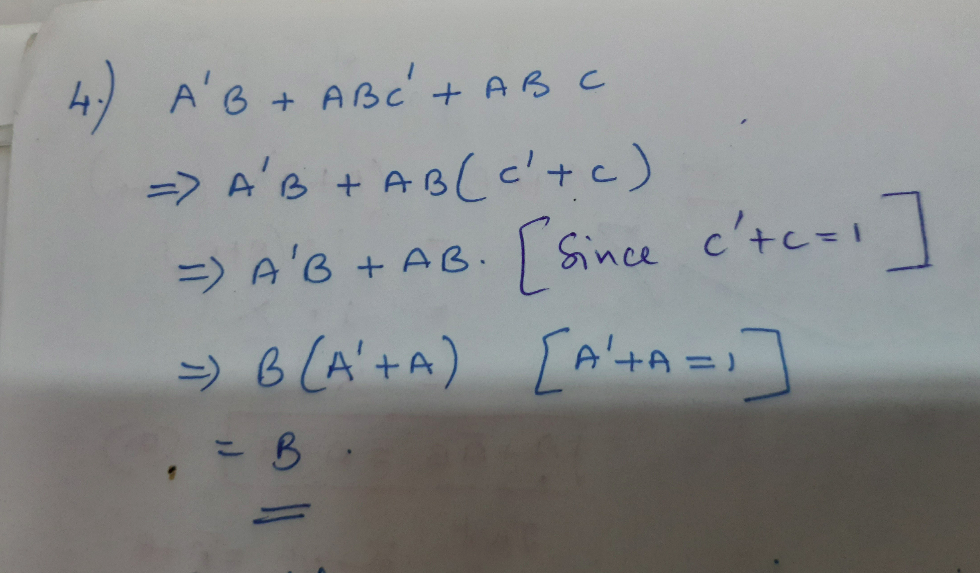

Slide 27
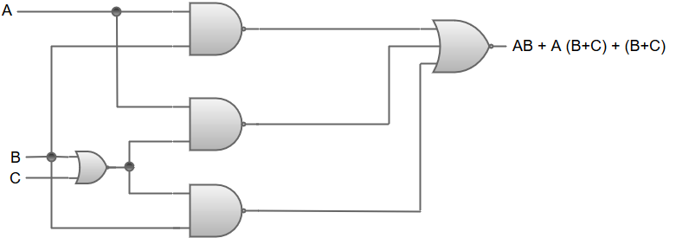
1) Consider an example of a Boolean function:
AB+A (B+C) + B (B+C)
The logic diagram for the Boolean function
AB+A (B+C) + B (B+C) can be represented as:
A+(B+C)
B(B+C)

Slide 28
We will simplify this Boolean function on the basis of rules given by Boolean algebra
AB + A (B+C) + B (B+C)
AB + AB + AC + BB + BC {Distributive law; A (B+C) = AB+AC, B (B+C) = BB+BC}
AB + AB + AC + B + BC {Idempotent law; BB = B}
AB + AC + B + BC {Idempotent law; AB+AB = AB}
AB + AC +B {Absorption law; B+BC = B}
B + AC {Absorption law; AB+B = B}
Hence, the simplified Boolean function will be B + AC.

Slide 29
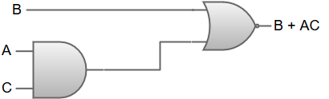
The logic diagram for Boolean function B + AC can be represented as:

Slide 30
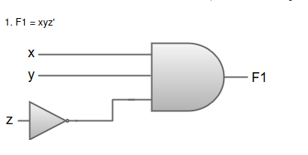

Slide 31
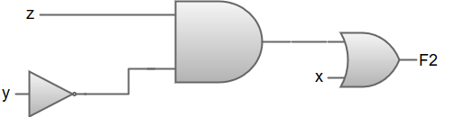
F2 = x + y'z

Slide 32
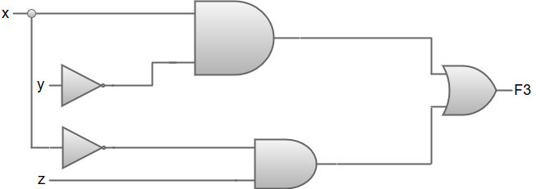
F3 = xy' + x'z

Slide 33
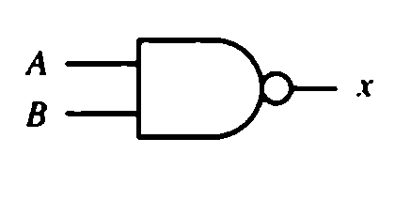
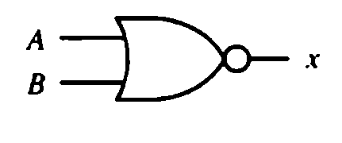
De-morgan’s theorem
1. It mainly deals with the NOR and NAND Gates.
2. It states that a NOR Gate performs the (x+y)’ function is equivalent to the function x’y’.
3.Similarly a NAND Gate can be expressed by either (xy)’ or (x’+y’).
As represented by the symbols:-

Slide 34
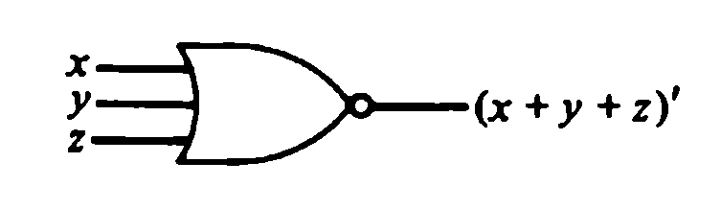
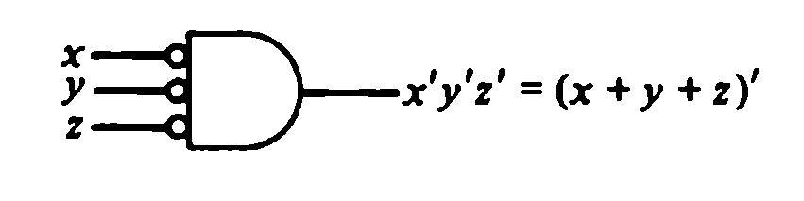
In De-Morgan’s Law,instead of representing a NOR gate with an OR graphic symbol followed by a circle, it can be represent by an AND graphic symbol preceded by circles in all inputs.
Figure of two graphic symbols for NOR gate:

Slide 35
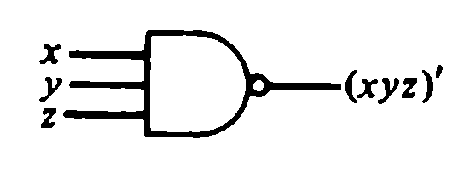
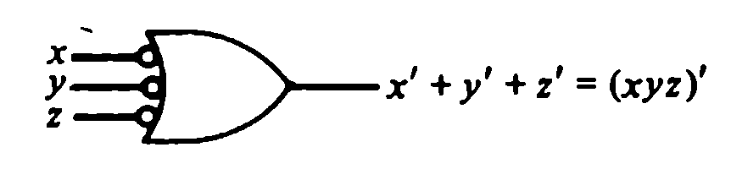
In De-Morgan’s Law, instead of representing a NAND gate with an AND graphic symbol followed by a circle, it can be represent by an OR graphic symbol preceded by circles in all inputs.
Figure of two graphic symbols for NAND gate:

Slide 36
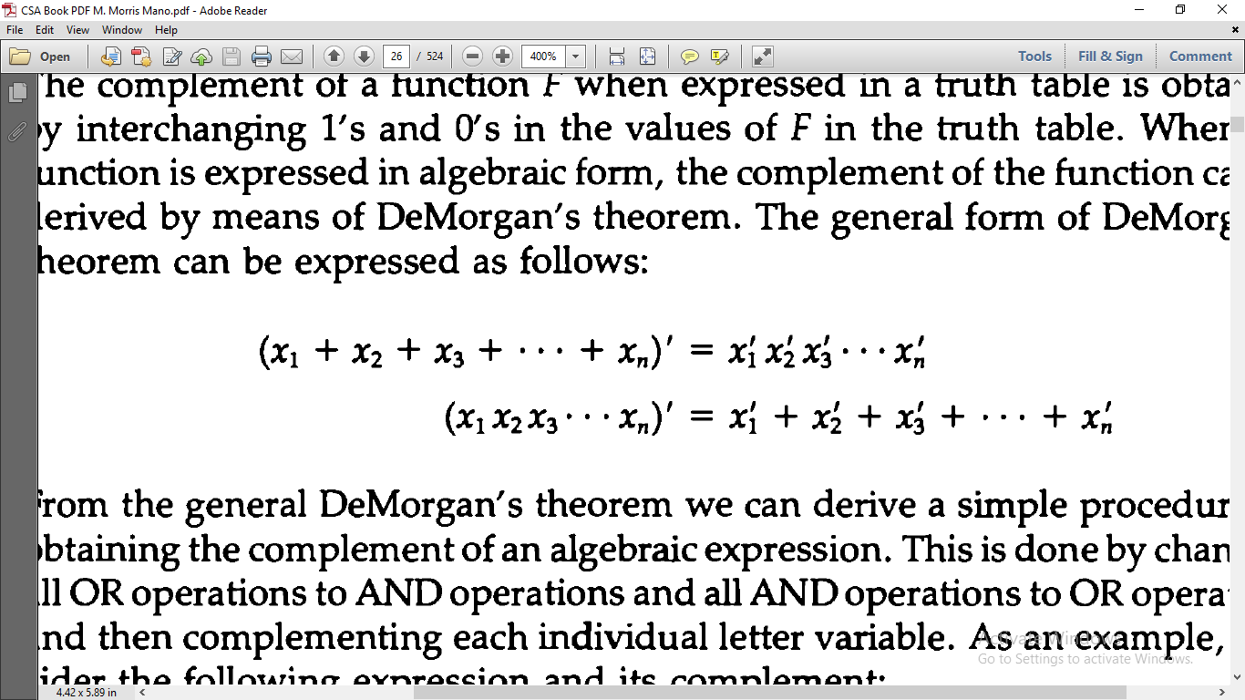
Complement of a function
The complement of a function F when expressed in a truth table is obtained by interchanging 1’s and 0’s in the values of F in the truth table.
General Form:
Or

Slide 37
4. Map simplification
The K-Map or Karnaugh map is a map method which provides a simple, straightforward procedure for simplifying Boolean expressions.
This method may be regarded as a pictorial arrangement of the truth table which allows an easy interpretation for choosing the minimum number of terms needed to express the function algebraically.

Slide 38
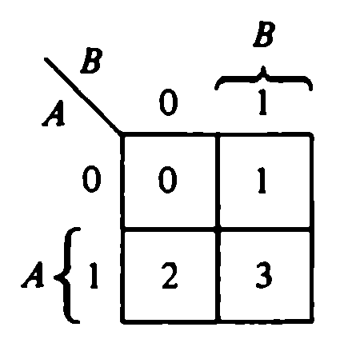
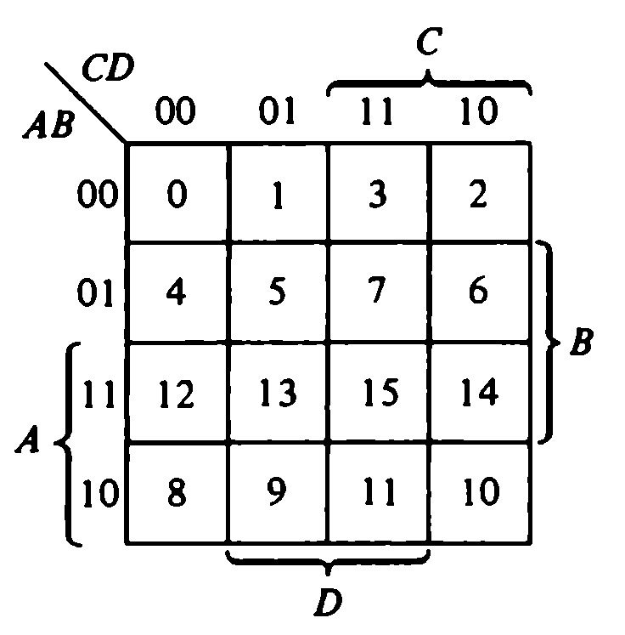
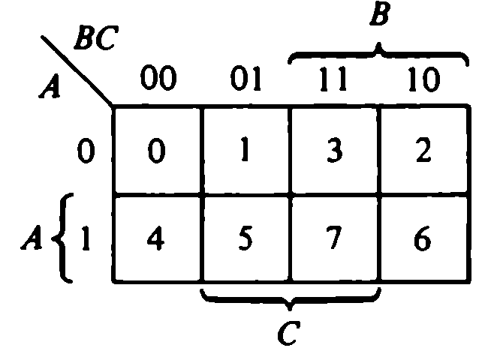
Each combination of the variables in a truth table is called a minterm. When expressed in a truth table a function of n variables will have 2^{n} minterms, equivalent to the 2^{n} binary numbers obtained from n bits.
Map for two-, three-, and four-variable map:-

Slide 39
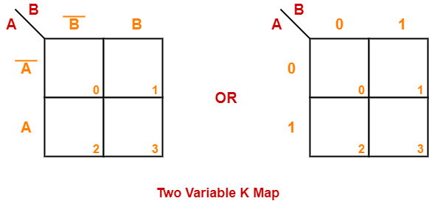
Two Variable K Map-
Two variable K Map is drawn for a boolean expression consisting of two variables.
The number of cells present in two variable K Map = 4 cells.
So, for a boolean function consisting of two variables, we draw a 2 x 2 K Map.

Slide 40
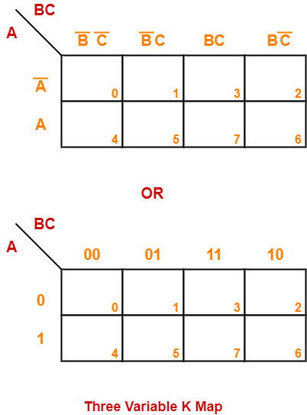
Three Variable K Map-

Slide 41
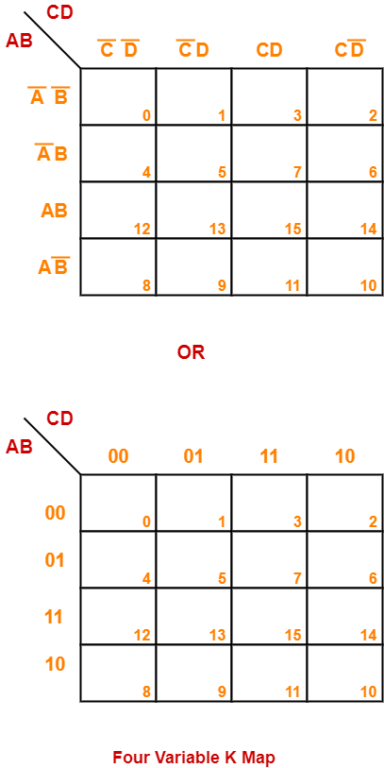

Slide 42
Karnaugh Map Simplification Rules-
To minimize the given boolean function,We draw a K Map according to the number of variables it contains.
We fill the K Map with 0’s and 1’s according to its function.
Then, we minimize the function in accordance with the following rules.
Rule-01:
We can either group 0’s with 0’s or 1’s with 1’s but we can not group 0’s and 1’s together.
X representing don’t care can be grouped with 0’s as well as 1’s.
NOTE
There is no need of separately grouping X’s i.e. they can be ignored if all 0’s and 1’s are already grouped.
Rule-02: Groups may overlap each other.

Slide 43
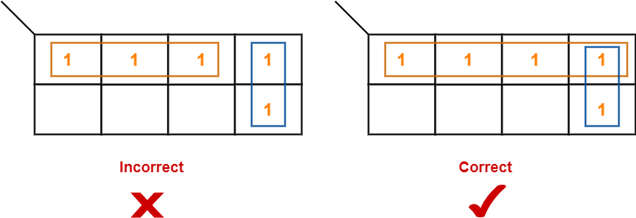
Rule-03:
We can only create a group whose number of cells can be represented in the power of 2.
In other words, a group can only contain 2n i.e. 1, 2, 4, 8, 16 and so on number of cells.

Slide 44
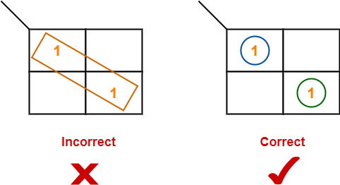
Rule-04:
Groups can be only either horizontal or vertical.
We can not create groups of diagonal or any other shape.

Slide 45
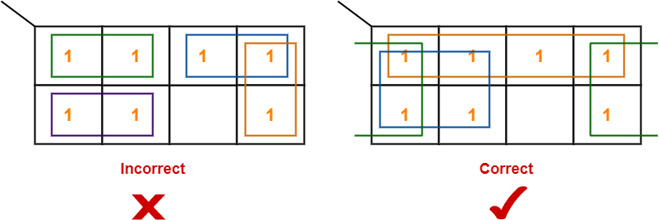
Rule-05:
Each group should be as large as possible.

Slide 46
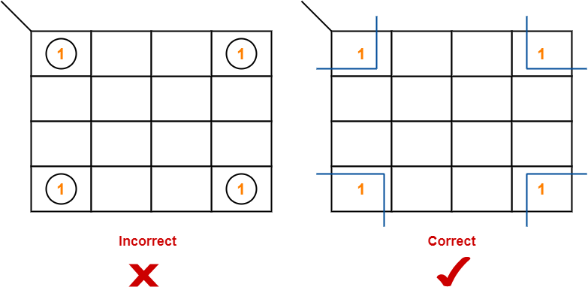
Rule-06:
Opposite grouping and corner grouping are allowed.
The example of opposite grouping is shown illustrated in Rule 5 .The example of corner grouping is shown below.

Slide 47
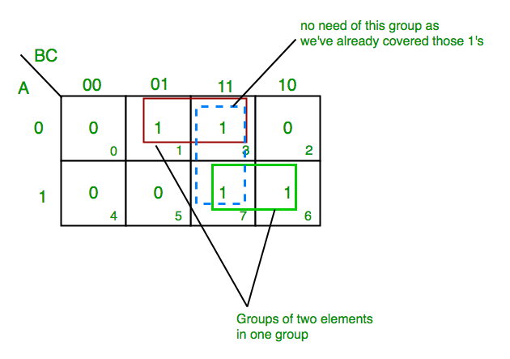
f(A,B,C)= ∑(1,3,6,7)

Slide 48
From red group we get product term— A’C
From green group we get product term— AB
Summing these product terms we get- Final expression (A’C+AB)

Slide 49
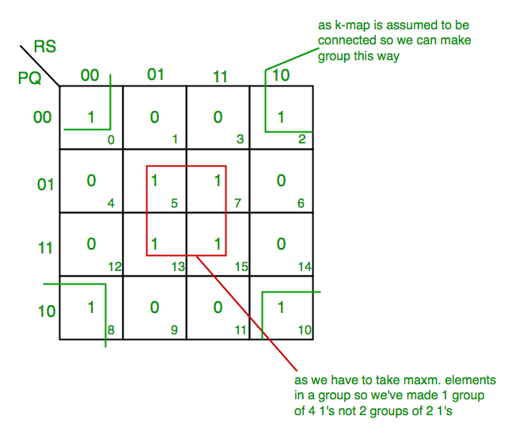
K-map for 4 variables
F(P,Q,R,S)=∑(0,2,5,7,8,10,13,15)

Slide 50
From red group we get product term—
QS
From green group we get product term—
Q’S’
Summing these product terms we get- Final expression (QS+Q’S’)

Slide 51
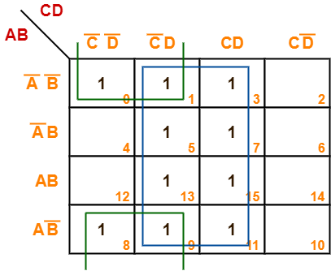
Problem-:
Minimize the following boolean function-
F(A, B, C, D) = Σm(0, 1, 3, 5, 7, 8, 9, 11, 13, 15)

Slide 52
Now,
F(A, B, C, D) = (AB + AB’)(C’D + CD) + (A’B’ + AB’)(C’D + CD) + (A’B’ + AB’)(C’D’ + C’D) + (A’B’ + A’B)(C’D’ + CD’)
= AD + B’D + B’C’ + A’D’
Thus, minimized boolean expression is-
F(A, B, C, D) = AD + B’D + B’C’ + A’D’

Slide 53
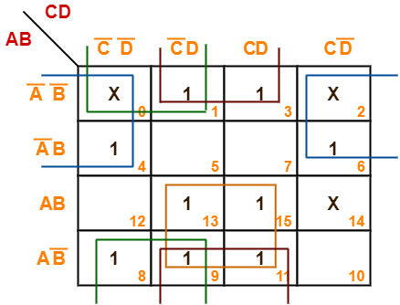
Minimize the following boolean function-
F(A, B, C, D) = Σm(1, 3, 4, 6, 8, 9, 11, 13, 15) + Σd(0, 2, 14)

Slide 54
Now,
F(A, B, C, D)
= (AB + AB’)(C’D + CD) + (A’B’ + AB’)(C’D + CD) + (A’B’ + AB’)(C’D’ + C’D) + (A’B’ + A’B)(C’D’ + CD’)
= AD + B’D + B’C’ + A’D’
Thus, minimized boolean expression is-
F(A, B, C, D) = AD + B’D + B’C’ + A’D’

Slide 55
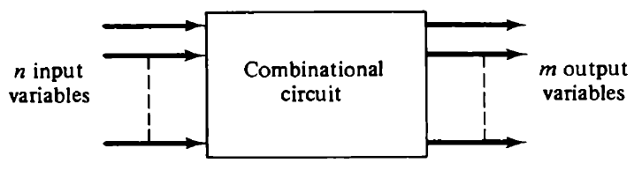
5. combinational circuit
A combinational circuit is a connected arrangement of logic gates with a set of inputs and outputs.
Logic Diagram:
The most common digital arithmetic circuit is the addition of two binary digit.

Slide 56
The design of combinational circuit starts from the verbal outline of the problem and ends in a logic circuit diagram. The procedure involves the following steps:
The problem is stated.
The input and output variables are assigned letter symbols.
The truth table that defines the relationship between inputs and outputs is derived.
The simplified Boolean functions for each output are obtained.
The logic diagram is drawn.

Slide 57
Half adder
A combinational circuit that performs the arithmetic addition of two bits is called a half-adder.
The input variables of a half adder are called the augend and addend bits.
The output variables are called the sum and the carry.

Slide 58
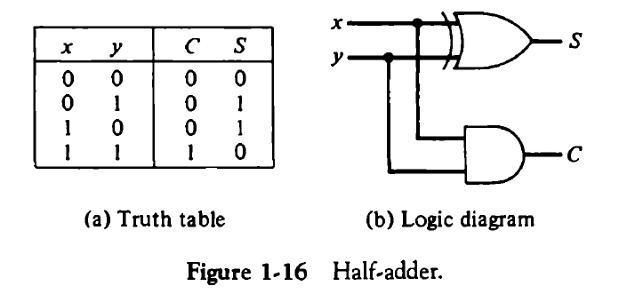
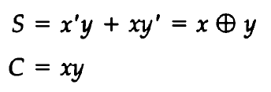

Slide 59
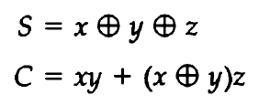
Full adder
A combinational circuit that performs the arithmetic addition of three bits is called a full-adder.
It consists of three inputs and two outputs.
Expression for the two outputs:

Slide 60
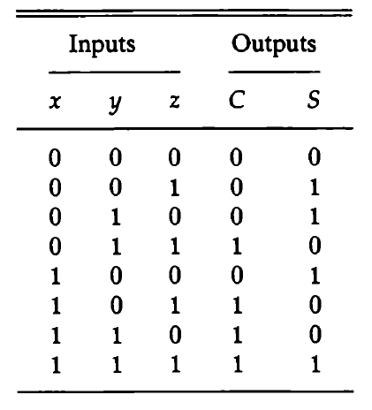
Truth table for Full Adder:

Slide 61
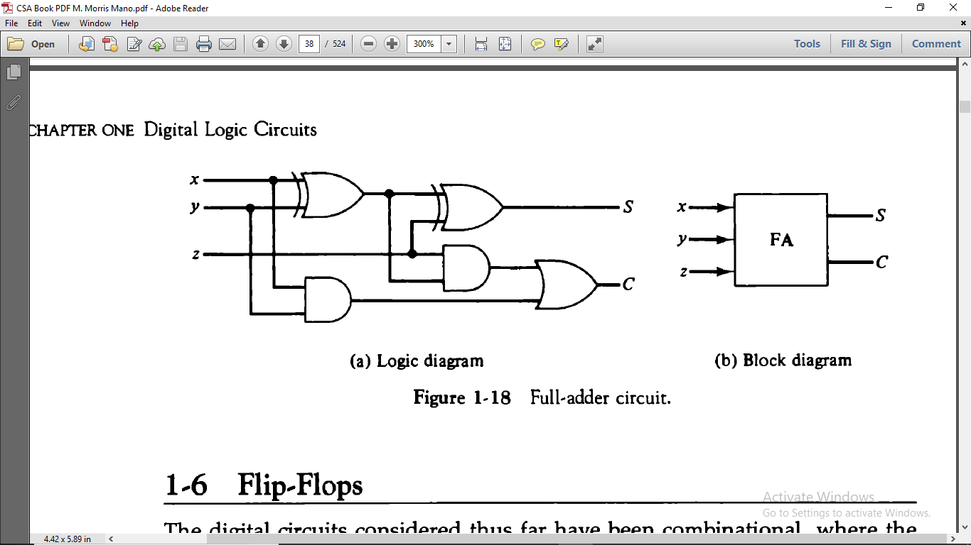
Logic Diagram:
Block Diagram:

Slide 62
6. flip flop
SR FLIP FLOP
D FLIP FLOP
JK FLIP FLOP
T FLIP FLOP
EDGE TRIGGERED FLIP FLOP

Slide 63
Clock Pulse:
  Synchronization is achieved by a timing device called a clock pulse generator that produces a periodic train of clock pulse.
Flip Flops: The storage elements employed in clocked sequential circuits are called flip flops.
Binary cell capable of storing one bit of information.
It has two outputs ,one for the normal value and other complemented value of the bit stored in it.

Slide 64
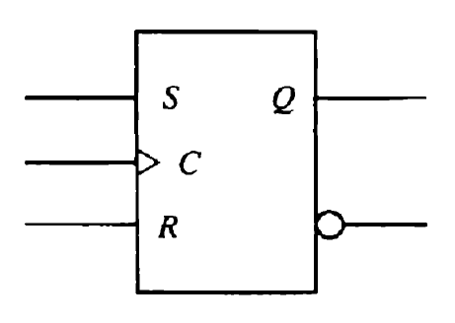
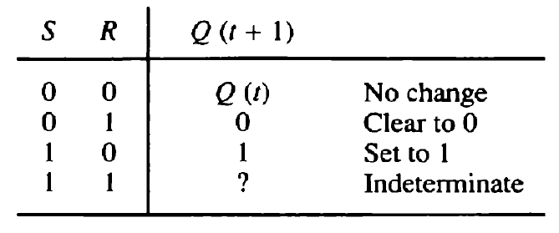
Sr flip flop
Graphic Symbol:
Characteristic Table:

Slide 65
Operation of SR Flip Flop:
S and R stands for S → set and R → reset.
If there is no signal at the clock input C, the output of the circuit cannot change irrespective of the values at inputs S and R.
But if, S=1 and R=0,
C changes from 0 → 1,
then output Q is set to 1.
If S=0 and R=1,
C changes from 0 → 1,
then output Q is cleared to 0.
If both the S and R are 0, output Q is unpredictable and may go to either 0 or 1, depending on internal timing delays that occur within the circuit.

Slide 66
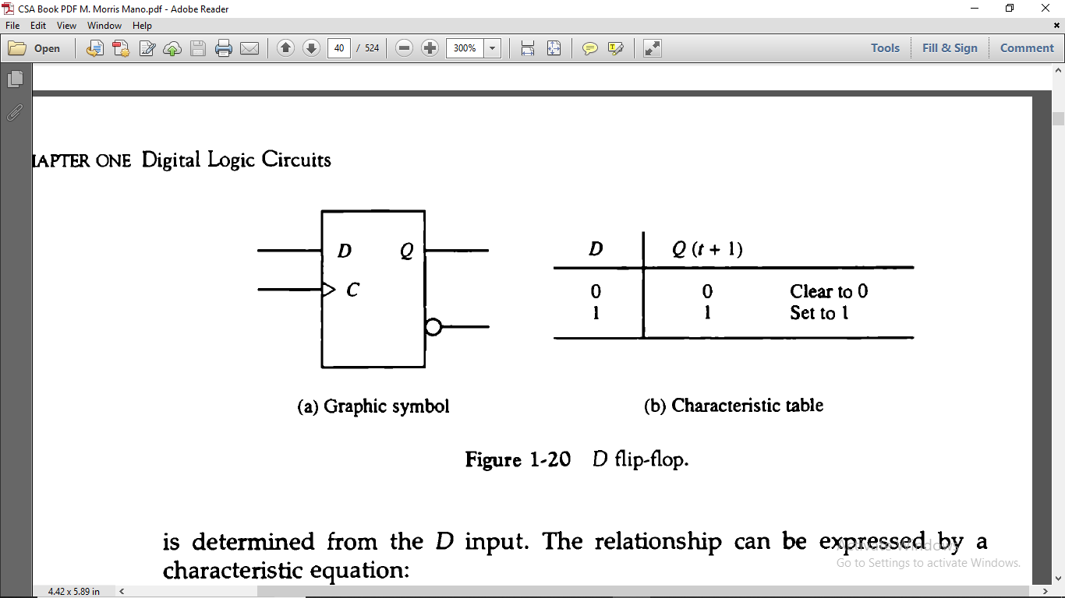
D flip flop
Graphic Symbol:
Characteristic Table:

Slide 67
Operation of D Flip Flop:
The D(data) flip flop is a slight modification of the SR flip flop. An SR is converted to D by inserting an inverter between S and R and assigning symbol D.
If, D=1, and the clock transition
i.e. C changes from 0 → 1
then output Q goes to the 1 state.
If, D=0, and the clock transition
i.e. C changes from 0 → 1
then output Q goes to the 0 state.
Here, in this, D flip flop, the relationship can be expressed by characteristic equation:
Q(t + 1) = D

Slide 68
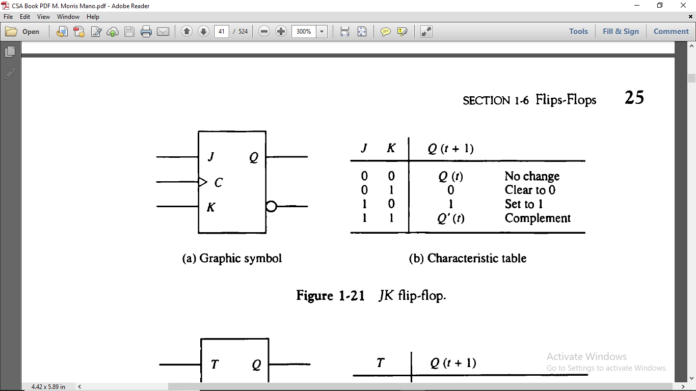
Jk flip flop
Graphic Symbol:
Characteristic Table:

Slide 69
Operation of JK flip flop:
A JK flip flop is a refinement of SR flip flop in that the indeterminate condition of the SR type is defined in the JK type.
If, J=0 and K=0,
and the clock transition i.e. C changes
then output does not changes.
If, J=0 and K=1,
and the clock transition i.e. C changes
then output clears to 0.
If, J=1 and K=0,
and the clock transition i.e. C changes
then output sets to 1.
When both inputs J and K are 1, a clock transition switches the output of the flip flop to their complement state

Slide 70
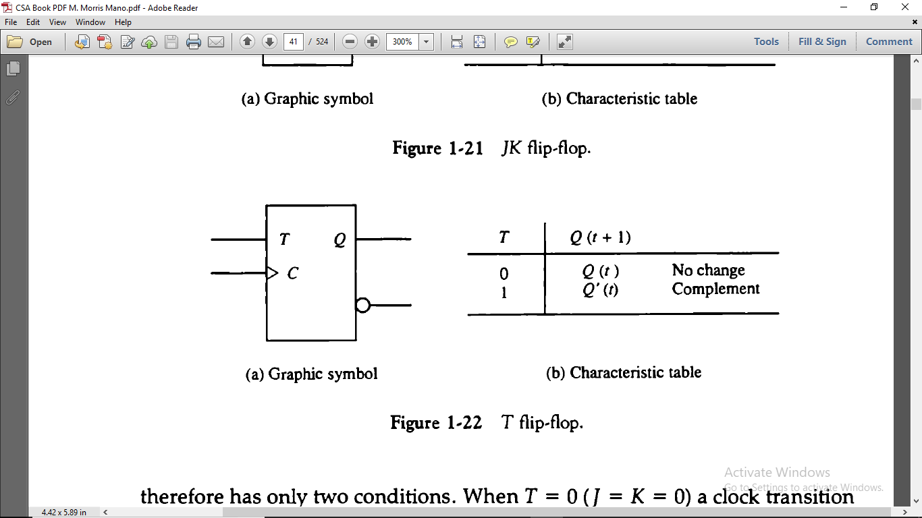
T flip flop
Graphic Symbol:
Characteristic Table:

Slide 71

Operation of T Flip Flop:
T flip flop is obtained from a JK type when inputs J and K are connected to provide a single input designated by T.
When T=0 i.e. J=K=0
clock transition does not changes the
state of the flip flop.
When T=1 i.e. J=K=1
clock transition complements the
state of the flip flop.
This condition can be expressed as:

Slide 72
Edge-triggered Flip-flop
The most common type of flip-flop used to synchronize the state change during a clock pulse transition is the edge-triggered flip flop.
In this type of flip flop, output transition occur at a specific level of the clock pulse.
Some edge-triggered flip-flops cause a transition on the rising edge of the clock signal i.e. +ve-edge transition, and others cause a transition on the falling edge i.e. –ve-edge transition.

Slide 73

Positive-edge-triggered flip-flop:
The value in the D input is transferred to the Q output when the clock makes a positive transition. The output cannot change when the clock is in the 1 level, or in a transition from the 1 level to the 0 level.

Slide 74

Negative-edge-triggered flip-flop:
The graphic symbol includes a negation small circle in front of the dynamic indicator at the C input. This denotes a negative-edge-triggered behaviour. In this case the flip-flop responds to a transition from the 1 level to the 0 level of the clock signal.

Slide 75
Master-Slave Flip-Flop:
This type of circuit consists of two flip-flops. The first is the master, which responds to the positive level of the clock.
The second is the slave, which responds to the negative level of the clock.
The result is that the output changes during the 1-to-0 transition of the clock signal.

Slide 76
Excitation tables
The characteristic table of flip-flops specify the next state when the inputs and the present state are known.
During the design of sequential circuits we usually know the required transition from present state to next state and wish to find the flip-flop input conditions that will cause the required transition.
For this reason we need a table that lists the required input combinations for a given change of state. Such a table is called a flip-flop excitation table.

Slide 77

Excitation Table for Four flip-flops:

Slide 78


Slide 79
x
Here the symbol represents a don’t care condition; that is, it does not matter whether the input to the flip-flop is 0 or 1.
The reason for the don’t care condition is as there are two ways of achieving the required transition.
For example:
In JK flip-flop, transition from present state of 0 to next state of 0 can be achieved by having J=K=0 (to obtain no change) or by J=0 and K=1 to clear the flip-flop.

Slide 80

7. Sequential circuits
A sequential circuit is an interconnection of flip-flops and gates.
Block diagram of a clocked synchronous sequential circuit:

Slide 81

Example of sequential circuit:

Slide 82
Thank You

